Slide 1
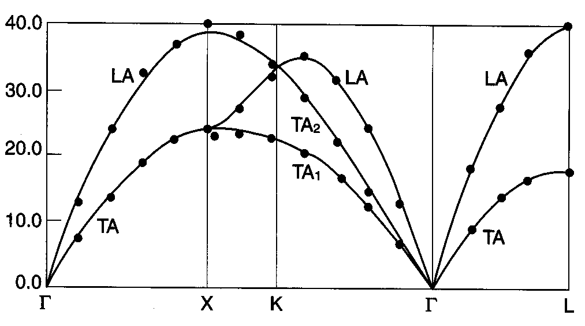
What can you tell me about this?
No class Friday. I’m filling in for Dunc at an important meeting in Southern WV. Slightly behind in the syllabus schedule, but I put in some catchup days.
Will send out HW today. Due in a week.
Notes:
Differences: More than one branch, not always largest at BZ edge
First hint is the labeling. Show the structure of BZ. Don’t worry if you can’t easily visualize that the BZ is BCC (thus real is FCC). Takes practice.
Looks like Al, monatomic FCC lattice, but Cu and neon look quite similar
Not much difference between gammaX and gammaL lines. Why? If you only knew what direction you were measuring and you saw this similarity, this would be one way to identify the crystal type (however, XRD is a much easier and cheaper experiment, so it wouldn’t typically make a lot of sense to do this for that purpose). What do transverse not look as similar?

Slide 2
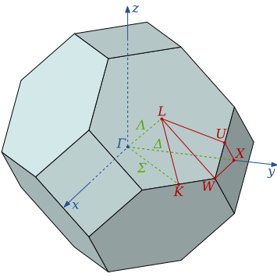
What can you tell me about this?
Equation we obtained is valid only for an isotropic solid, where vibrational frequency does not depend on the direction.
Notes:
Differences: More than one branch, not always largest at BZ edge
First hint is the labeling. Show the structure of BZ. Don’t worry if you can’t easily visualize that the BZ is BCC (thus real is FCC). Takes practice.
Looks like Al, monatomic FCC lattice, but Cu and neon look quite similar
Not much difference between gammaX and gammaL lines. Why? If you only knew what direction you were measuring and you saw this similarity, this would be one way to identify the crystal type (however, XRD is a much easier and cheaper experiment, so it wouldn’t typically make a lot of sense to do this for that purpose). What do transverse not look as similar?

Slide 3
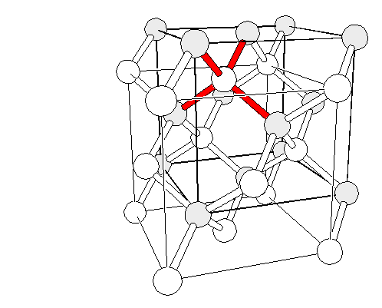
Predict for Diamond along one direction (try 001)
Notes:
LA always greater energy than TA, but not always the case for LO versus TO

Slide 4
Predict for Diamond along one direction (try 001)
(0,0,0)
fcc lattice with basis
P=2
Notes:
LA always greater energy than TA, but not always the case for LO versus TO

Slide 5
Predict for Diamond along one direction (try 001)
(0,0,0)
fcc lattice with basis
P=2
2x3=6 branches expected
Notes:
LA always greater energy than TA, but not always the case for LO versus TO

Slide 6
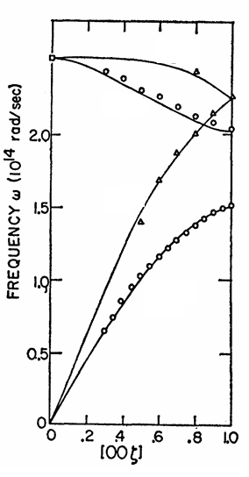
Predict for Diamond along one direction (try 001)
http://exciting-code.org/phonon-properties-in-diamond-structure-crystals
(0,0,0)
fcc lattice with basis
P=2
Which branch is which?
(acoustic, longitudinal, optical, transverse)
2x3=6 branches expected
Notes:
LA always greater energy than TA, but not always the case for LO versus TO

Slide 7
Predict for Diamond along one direction (try 001)
http://exciting-code.org/phonon-properties-in-diamond-structure-crystals
Longitudinal Optical
Transversal Optical
degenerate
Longitudinal Acoustic
(0,0,0)
fcc lattice with basis
Transversal Acoustic
degenerate
P=2
Which branch is which?
(acoustic, longitudinal, optical, transverse)
2x3=6 branches expected
Notes:
LA always greater energy than TA, but not always the case for LO versus TO

Slide 8
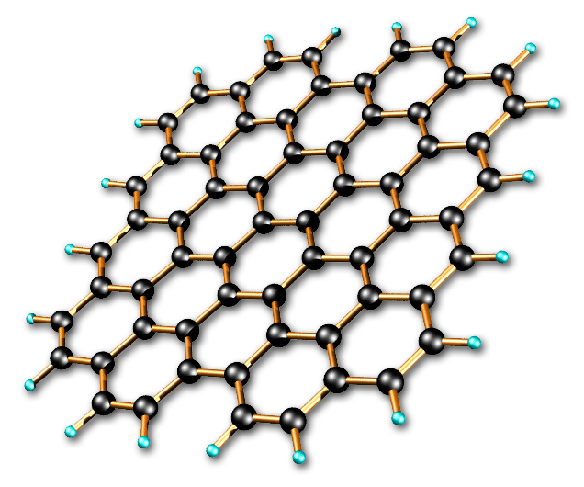
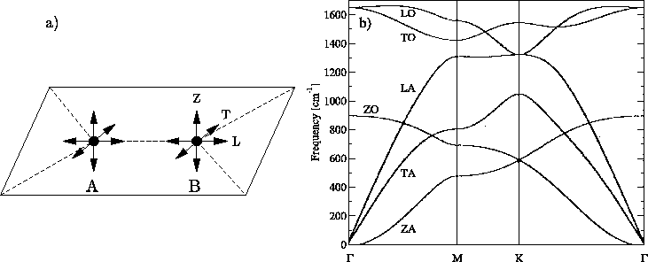
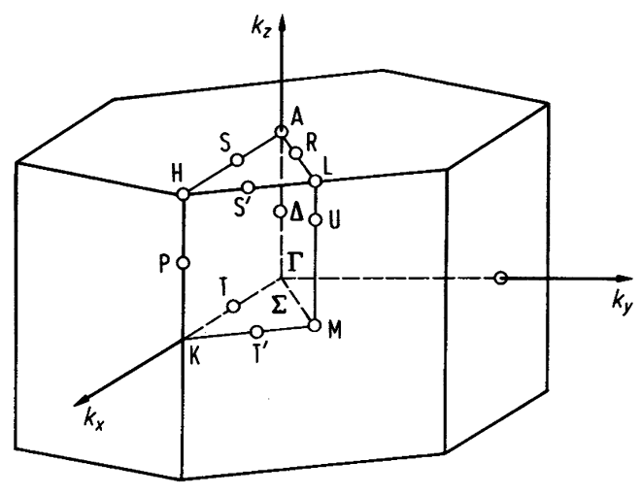
Can you guess what this is?
What makes this look quite different?
How could we measure this?
All measurements before from neutrons.
Notes:
One of these transverse modes is really different! The out of plane. Why might that happen?
At least something like this is also going to happen for other 2D materials, as well.

Slide 9
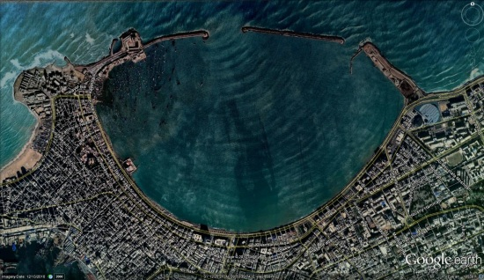
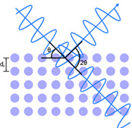
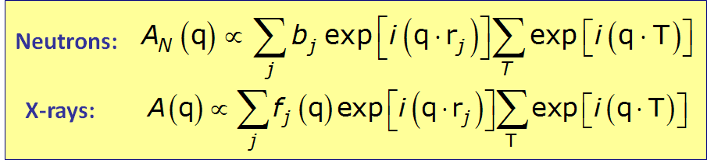
Diffraction Methods
Diffraction
X-ray
Neutron
Electron
The physical basis for the diffraction of electron and neutron beams is the same as that for the diffraction of X-rays, the only difference is the mechanism of scattering.
Notes:
Electron diffraction is similar to X-ray diffraction (XRD), except it uses a beam of electrons to obtain a diffraction pattern from the sample of interest. It is usually performed in a TEM where the electrons pass through a thin film of the sample to be analyzed. Also used in RHEED to improve MBE growth (will discuss later).

Slide 10
Advantages and disadvantages of X-rays
Advantages:
X-ray is the cheapest, the most convenient and widely used method.
X-rays are not absorbed very much by air, so the specimen need not be in an evacuated chamber (unlike electron diffraction).
Disadvantages:
They do not interact very strongly with lighter elements.
Not strongly sensitive to magnetism (need synchrotron).

Slide 11
Neutron Diffraction for Phonons
Neutrons were discovered in 1932 and their wave properties was shown in 1936.
λ ~1A°
Energy E~0.08 eV. On the same order of magnitude as the thermal energy (k_{B}T) at room temperature, 0.025 eV, and for this reason they are good at probing phonons.
E = p²/2m p = h/λ
E=Energy λ=Wavelength
p=Momentum
m_{n}=Mass of neutron = 1.67x10⁻²⁷kg
Notes:
H=6.6x10^-34

Slide 12
The energy of other methods
X-Ray
Neutron
Electron
λ = 1A°
E ~ 10⁴ eV
interact with electron
Penetrating
λ = 1A°
E ~ 0.08 eV
interact with nuclei
Highly Penetrating
λ = 2A°
E ~ 150 eV
interact with electron
Less Penetrating
~ Bulk Measurement Bulk Measurement Surface Sensitive if sample is thin (<100s nm)
Notes:
Note that penetration does not scale with energy. It depends more on the mechanism (and then the energy).

Slide 13
Neutron Diffraction
Unlike the x-ray, which is scattered entirely by electrons, neutrons are scattered by nuclei.
Neutrons are more useful than X-rays for determining the crystal structures of solids containing light (low atomic number) elements.
Although uncharged, neutron has an intrinsic magnetic moment, so it will interact strongly with atoms and ions in the crystal which also have magnetic moments.
Neutron sources in the world are limited so neutron diffraction is a very special tool.

Slide 14
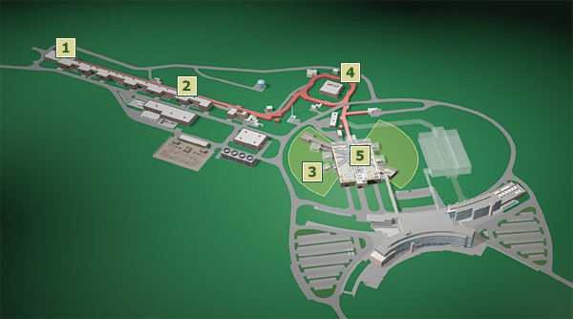
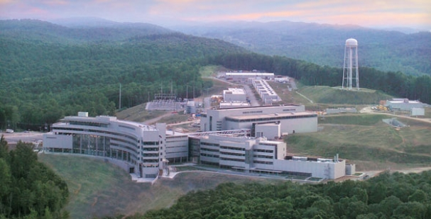
Oak Ridge, Tennessee
Start with negatively charged hydrogen ions, produced by an ion source (1 proton and 2 electrons). Ions injected into a linear accelerator.
The ions pass through a foil, which strips off the electrons, converting it to a proton.
Notes:
This is not the only way to create a neutron source. Uranium is a common target, instead of mercury.
Spallation is a process in which fragments of material (spall) are ejected from a body due to impact or stress. In neutron scattering instruments, neutrons are generated by bombarding a target with a stream of atoms. The neutrons that are ejected from the target are known as spall.

Slide 15
Oak Ridge, Tennessee
Start with negatively charged hydrogen ions, produced by an ion source (1 proton and 2 electrons). Ions injected into a linear accelerator.
The ions pass through a foil, which strips off the electrons, converting it to a proton.
The high-energy protons strike a target of liquid mercury, kicking out neutrons (known as spallation).
The spalled neutrons are guided through beam lines.
Notes:
This is not the only way to create a neutron source. Uranium is a common target, instead of mercury.
Spallation is a process in which fragments of material (spall) are ejected from a body due to impact or stress. In neutron scattering instruments, neutrons are generated by bombarding a target with a stream of atoms. The neutrons that are ejected from the target are known as spall.

Slide 16
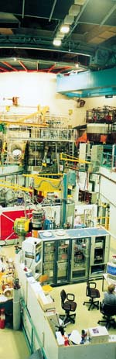
Very expensive and involved experiments (construction of Oak Ridge neutron source was ~ $1 billion)
Table top alternatives
?
Lonely scientist in the reactor hall
Notes:
Atomic scattering factors decrease as Q squared for light methods
Brillouin when photon absorbed is an acoustic phonon, Raman when its an optical phonon. Absorbed or emitted is anti-Stokes vs Stokes.

Slide 17
Very expensive and involved experiments (construction of Oak Ridge neutron source was ~ $1 billion)
Table top alternatives
?
Yes, infrared absorption and
inelastic light scattering (Raman and Brillouin)
Lonely scientist in the reactor hall
Notes:
Atomic scattering factors decrease as Q squared for light methods
Brillouin when photon absorbed is an acoustic phonon, Raman when its an optical phonon. Absorbed or emitted is anti-Stokes vs Stokes.

Slide 18
Very expensive and involved experiments (construction of Oak Ridge neutron source was ~ $1 billion)
Table top alternatives
?
Yes, infrared absorption and
inelastic light scattering (Raman and Brillouin)
However only k~0 accessible (atomic scattering factors decrease as k² for light)
Lonely scientist in the reactor hall
Notes:
Atomic scattering factors decrease as Q squared for light methods
Brillouin when photon absorbed is an acoustic phonon, Raman when its an optical phonon. Absorbed or emitted is anti-Stokes vs Stokes.

Slide 19
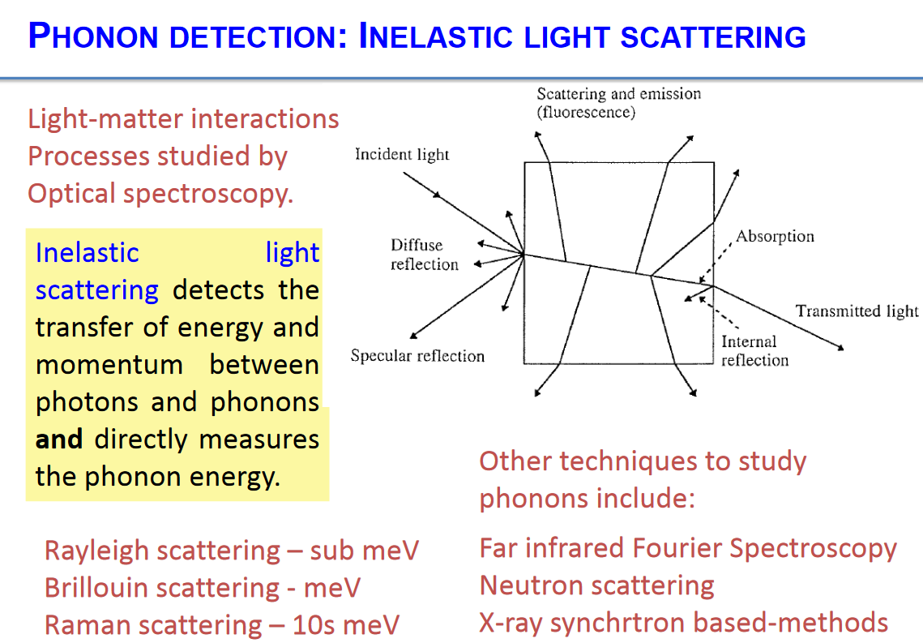

Slide 20
Phonon spectroscopy =
Conditions for: elastic scattering
Notes:
Maybe draw Feynman diagram for phonon absorption (and maybe creation too)

Slide 21


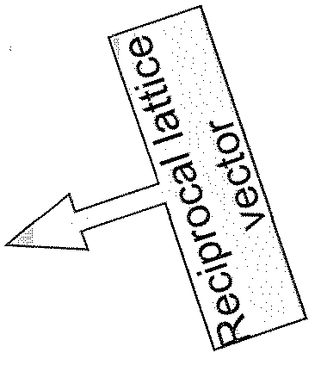
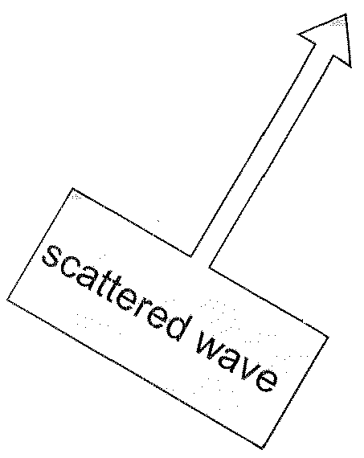
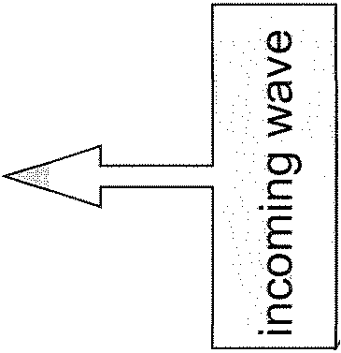
Phonon spectroscopy =
Conditions for: elastic scattering
Constraints:
Conservation laws of
Momentum
Energy
Notes:
Maybe draw Feynman diagram for phonon absorption (and maybe creation too)

Slide 22


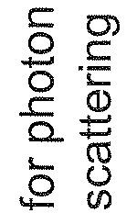
Phonon spectroscopy =
Conditions for: elastic scattering
Constraints:
Conservation laws of
Momentum
Energy
Notes:
Maybe draw Feynman diagram for phonon absorption (and maybe creation too)

Slide 23


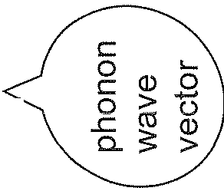
Phonon spectroscopy =
Conditions for: elastic scattering
in
Constraints:
Conservation laws of
Momentum
Energy
Notes:
Maybe draw Feynman diagram for phonon absorption (and maybe creation too)

Slide 24
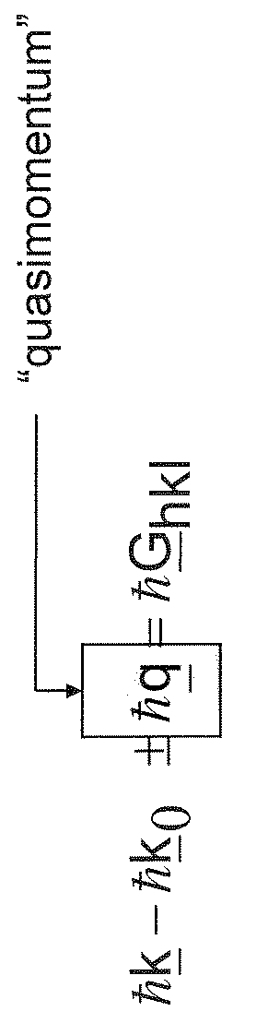
Phonon spectroscopy =
Conditions for: elastic scattering
in
Constraints:
Conservation laws of
Momentum
Energy
Notes:
Maybe draw Feynman diagram for phonon absorption (and maybe creation too)

Slide 25
Phonon spectroscopy =
Conditions for: elastic scattering
in
Constraints:
Conservation laws of
Momentum
Energy
In all interactions involving phonons, energy must be conserved and crystal momentum must be conserved to within a reciprocal lattice vector.
Notes:
Maybe draw Feynman diagram for phonon absorption (and maybe creation too)

Slide 26
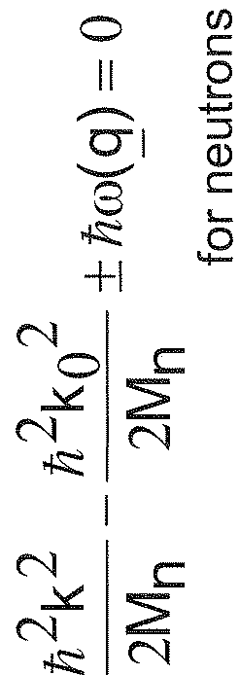
Phonon spectroscopy =
Conditions for: elastic scattering
in
Constraints:
Conservation laws of
Momentum
Energy
In all interactions involving phonons, energy must be conserved and crystal momentum must be conserved to within a reciprocal lattice vector.
Notes:
Maybe draw Feynman diagram for phonon absorption (and maybe creation too)

Slide 27
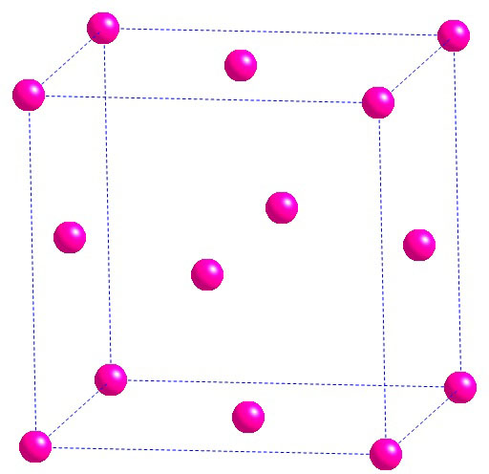
Magnetic Applications of Neutron Diffraction
Establishing magnetic structure of materials
Neutrons carry magnetic moments and their scattering is affected by magnetic moments of atoms
Example:
Magnetism of MnO
Which are cations/anions? How many missing extra electrons?
Mn²⁺ ions
face-centered cube
Mn
Notes:
Fcc with how many atoms in the basis? 2
This particular basis gives the rocksalt structure (same for NaCl)

Slide 28
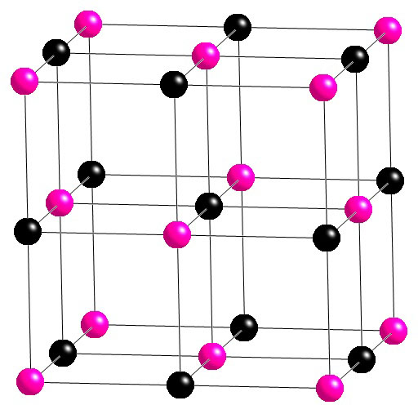
Magnetic Applications of Neutron Diffraction
Establishing magnetic structure of materials
Neutrons carry magnetic moments and their scattering is affected by magnetic moments of atoms
Example:
Magnetism of MnO
Mn²⁺ ions
face-centered cube
O²⁻ ions
in the centers of all edges
and in the body center
What crystal structure?
Mn
O
Notes:
Fcc with how many atoms in the basis? 2
This particular basis gives the rocksalt structure (same for NaCl)

Slide 29
Magnetic Applications of Neutron Diffraction
Establishing magnetic structure of materials
Neutrons carry magnetic moments and their scattering is affected by magnetic moments of atoms
Example:
Magnetism of MnO
Mn²⁺ ions
face-centered cube
O²⁻ ions
in the centers of all edges
and in the body center
Mn
O
Notes:
Fcc with how many atoms in the basis? 2
This particular basis gives the rocksalt structure (same for NaCl)

Slide 30
Magnetic Applications of Neutron Diffraction
Establishing magnetic structure of materials
Neutrons carry magnetic moments and their scattering is affected by magnetic moments of atoms
Example:
Magnetism of MnO
Mn²⁺ ions
face-centered cube
O²⁻ ions
in the centers of all edges
and in the body center
Mn
O
X-ray diffraction wouldn’t be sensitive to these spins, but neutrons are.
Notes:
Fcc with how many atoms in the basis? 2
This particular basis gives the rocksalt structure (same for NaCl)

Slide 31
Magnetic Applications of Neutron Diffraction
Establishing magnetic structure of materials
Neutrons carry magnetic moments and their scattering is affected by magnetic moments of atoms
Example:
Magnetism of MnO
Mn²⁺ ions
face-centered cube
O²⁻ ions
in the centers of all edges
and in the body center
Mn
O
X-ray diffraction wouldn’t be sensitive to these spins, but neutrons are.
What happens to the unit cell when you add the magnetic structure?
Notes:
Fcc with how many atoms in the basis? 2
This particular basis gives the rocksalt structure (same for NaCl)

Slide 32
Simple Cubic Magnetic Super-Structure showing only magnetic elements
Ignoring this effect what peaks do we expect for MnO in diffraction?
c
c
a
a
Anti-Ferromagnetic=FM in one plane but antiparallel in next plane, M=0
Magnetic and charge have the different unit cells. Magnetic unit cell doubles nuclear unit cell.
Ferromagnetic (FM)=has a spontaneous magnetization whose direction can be changed with a magnetic field
Magnetic and charge have the same unit cell
Notes:
Fcc had all even or all odd hkl for diffraction planes

Slide 33
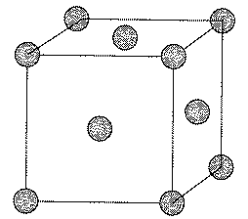
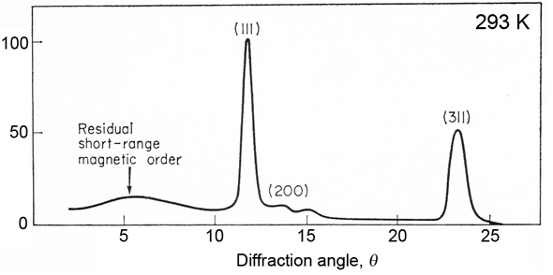
Magnetism of MnO
(from Kittel)
Above magnetic ordering temp
Chemical unit cell (FCC)
(all odd or
even h,k,l)
How do we expect this to change below the magnetic ordering temperature?
Notes:
Next two small peaks are 331 and 511, a=8.85 Angstroms as opposed to 4.43 in other example
Could also discuss magnetic reflectometry

Slide 34
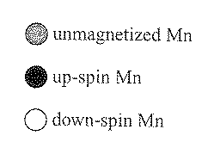
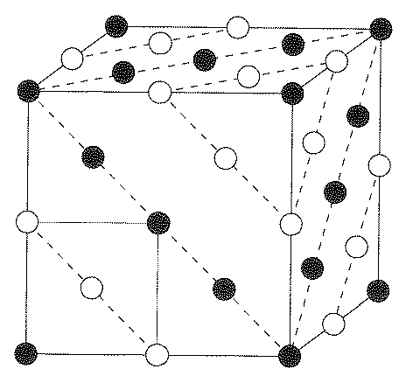
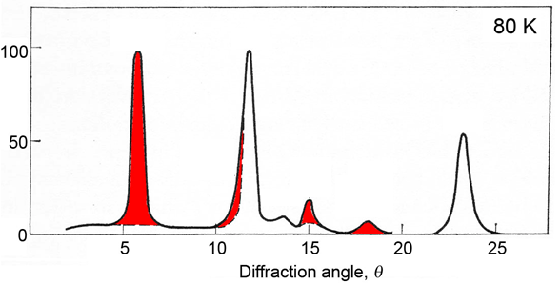
Magnetism of MnO
(from Kittel)
Above magnetic ordering temp
Chemical unit cell (FCC)
(all odd or
even h,k,l)
Magnetic unit cell
Below magnetic ordering temp
How do we expect this to change below the magnetic ordering temperature?
Notes:
Next two small peaks are 331 and 511, a=8.85 Angstroms as opposed to 4.43 in other example
Could also discuss magnetic reflectometry

Slide 35
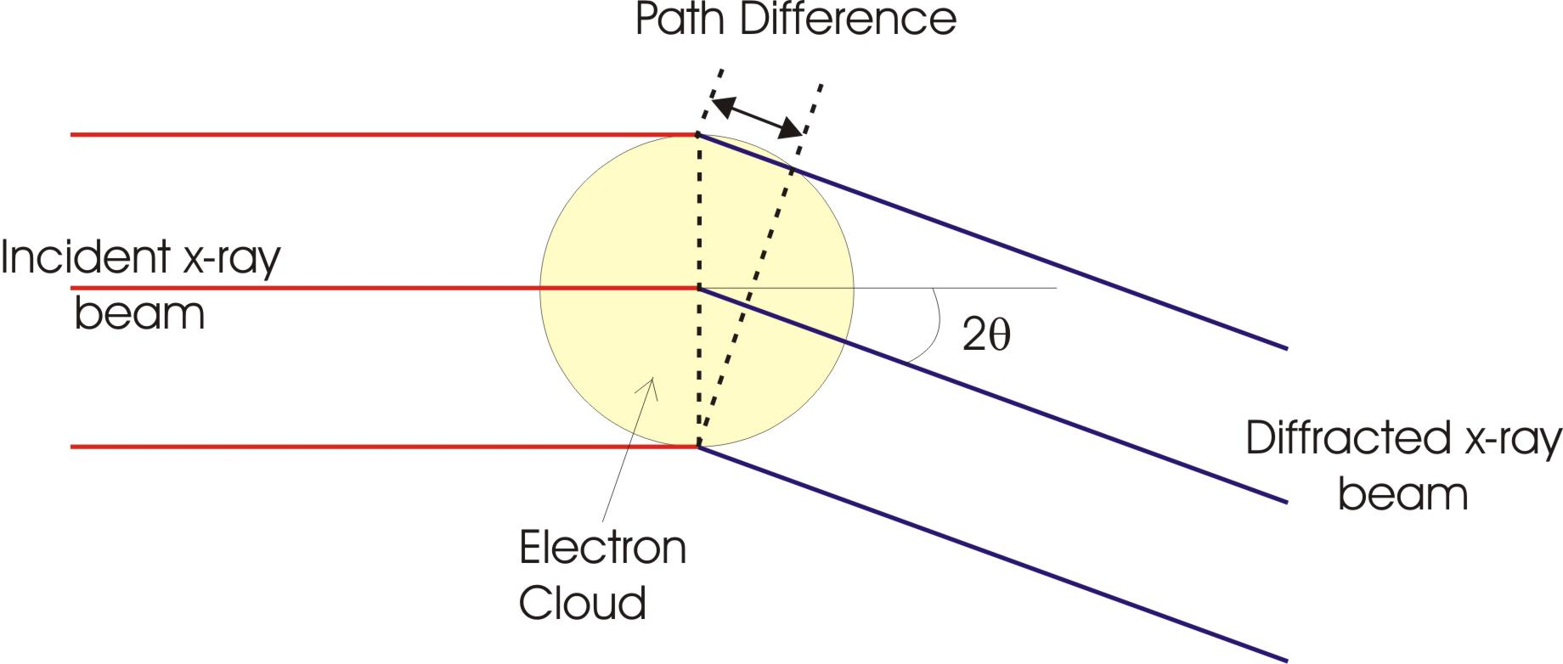
Consider Neutron Diffraction
Qualitatively discuss the atomic scattering factor (e.g., as a function of scattering angle) for neutron diffraction (compared to x-ray) by a crystalline solid.
For x-rays, we saw that f has a strong angular component. For neutrons?
The same concept applies, but since the neutron scatters off a tiny nucleus, scattering is more point-like, and f is independent of θ.
Notes:
3.9

Slide 36
But not constant for neutrons studying magnetism. Why?
Neutrons are sensitive to both the nuclear and magnetic structure.
Notes:
Got here (slide 17) in 75 minute class

Slide 37
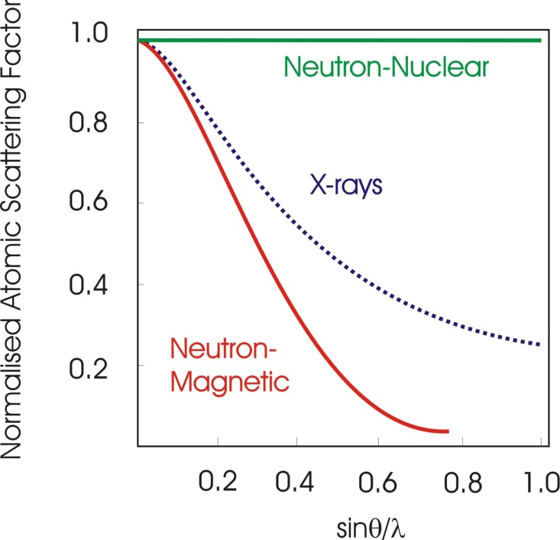
But not constant for neutrons studying magnetism. Why?
As the magnetism arises from unpaired electrons in outer shells and not the nucleus there is a dependence on intensity, similar to the sin(θ) / λ used for x-rays
Neutrons are sensitive to both the nuclear and magnetic structure.
Notes:
Even more in neutron-magnetic because only the outer electrons have unpaired spins, whereas x-rays scatter off the whole electron cloud (which is on average closer than just the outer electrons)

Slide 38

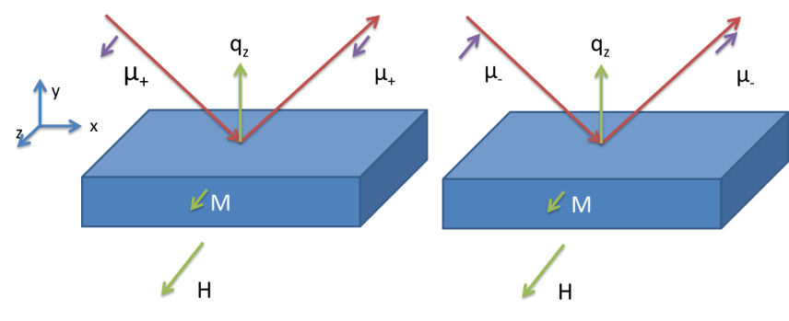
Holcomb Neutron Measurements
@ NIST
17.0nm LSMO
Polarized Neutron Reflectivity
Similarities with XRR
Notes:
Interested in seeing how varying parameters changes this profile.

Slide 39
Magnetism Enhanced at Interface
@ NIST
17.0nm LSMO
Polarized Neutron Reflectivity
Similarities with XRR
Nuclear Scattering
Depth dependent magnetization
Notes:
Interested in seeing how varying parameters changes this profile.

Slide 40
Magnetism Enhanced at Interface
@ NIST
17.0nm LSMO
Polarized Neutron Reflectivity
Similarities with XRR
Nuclear Scattering
Enhanced Magnetism
“Dead” Layer
Depth dependent magnetization
Notes:
Interested in seeing how varying parameters changes this profile.

